Slide 1





SEC 10K-Filings
Preprocessed Documents
-> Removing HTML-Attributes, Empty HTML Tags, XBLR Tags
Splitted Documents
-> Recursive Character Text Splitter based on HTML (Chunk Length = 6,000 chars; Overlap = 10 %)
Embeddings
-> Snowflake Arctic-embed-m-v1.5
Qdrant Collection
-> Local Docker Instance
Sharing ID
Store Full Documents
-> Right now on Disk, but maybe Database?

Slide 2




Load
Indexing & Retrieval
Qdrant Collection
-> Vectorstore
Load
Document & Table Loader
Questions Doc Loader
Online Data Source
Document Service
Document Splitter
Indexing & Retrieval Service
Write & Load
Embedding API
-> OpenAI, Azure Foundry
Local
Document Store
-> Raw Data
Document Preprocessor
Retrieval
Evaluation
Text Generation Service
Evaluation Service
Table Serializer
QA Evaluation
TabTree
Implementation
TabTree Serializer
HTML
…
Langchain
Pipeline
TabTree
Tests
Context Detection
Chat Completions API
-> OpenAI, Azure Foundry

Slide 3




Full Documents
Preprocessed Documents
Transformed Documents
Document Chunking
Chunk Embeddings
Vector Store
Table Extraction
Table Serialization

Slide 4
Full Documents
Preprocessed Documents
Transformed Documents
Document Chunking
Chunk Embeddings
Vector Store
Table Extraction
Table Serialization

Slide 5
Full Documents
Preprocessed Documents
Document Chunking
Chunk Embeddings
Vector Store

Slide 6
Full Documents
Preprocessed Documents
Document Chunking
Chunk Embeddings
Vector Store

Slide 7
Indexing Vanilla RAG
Indexing
Table QA Framework

Slide 8

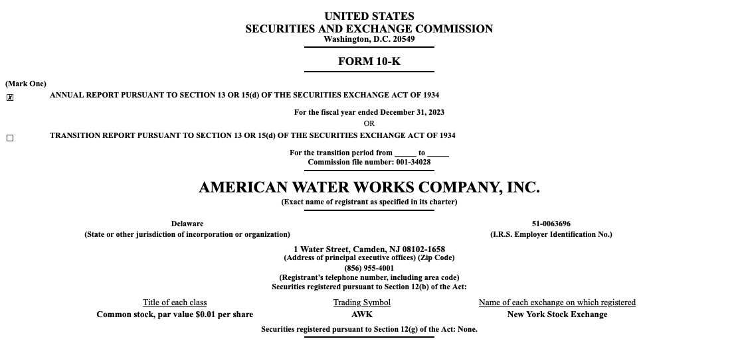
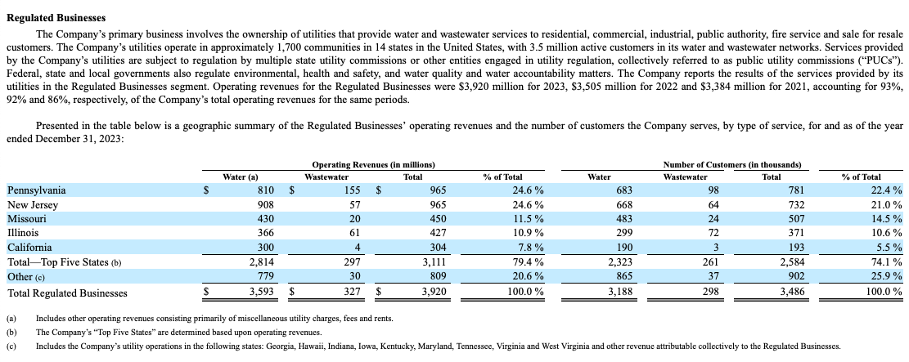
Document Corpus
Unit Elements
…
…

Slide 9

Document Corpus
Relevant Chunk

Slide 10

Question
What is the age of the youngest student?
Document

Slide 11
Document

Slide 12

Serialized Chunk
Question
What is the age of the youngest student?
<table>
<thead>
<tr>
<th colspan="7">grades</th>
</tr>
...
</thead>
<tbody>
...
</tbody>
</table>
Answer
16

Slide 13
Initial Chunk

Slide 14
Relevant Chunk

Slide 15
Relevant Chunk

Slide 16
Question
What is the age of the youngest student?
Chunk Serialization
Answer
16

Slide 17

Question
What is the age of the youngest student in the ‚Science College‘?
Answer
16
Documents
Table QA Framework
Incl. Table Serialization

Slide 18
Question
What is the age of the youngest student?
Chunk
Retrieval
Answer
16

Slide 19
Question
What is the age of the youngest student?
Chunk
Retrieval
Chunk
Serialization
Answer
16

Slide 20
Document
Chunks
…
…
…
…

Slide 21





Document
$$e_{1}$$
Text
…
…
$$e_{i}$$
$$e_{i+1}$$
…
…
$$e_{i+2}$$

Slide 22
Table
$$e_{1}$$
Text
…
…
$$e_{i}$$
$$e_{i+1}$$
…
…
$$e_{i+2}$$

Slide 23
j = 1
j = 2
j = 3
j = 4
j = 5
j = 6
j = 7
i = 1
grades
 |  |  | 2023 |  | 2024
class | name | age | math | english | math | english
A | John | 17 | A | C | A | B
 | Tiffany | 16 | B | B | C | B
B | Michael | 17 | D | D | D | D
i = 2
i = 3
i = 4
i = 5
i = 6

Slide 24
Initial Table
j = 1
j = 2
j = 3
j = 4
j = 5
j = 6
j = 7
i = 1
grades
 |  |  | 2023 |  | 2024
class | name | age | math | english | math | english
A | John | 17 | A | C | A | B
 | Tiffany | 16 | B | B | C | B
B | Michael | 17 | D | D | D | D
i = 2
i = 3
i = 4
i = 5
i = 6

Slide 25
j = 1
j = 2
j = 3
j = 4
Column Header Cell
j = 5
j = 6
j = 7
i = 1
grades
 |  |  | 2023 |  | 2024
class | name | age | math | english | math | english
A | John | 17 | A | C | A | B
 | Tiffany | 16 | B | B | C | B
B | Michael | 17 | D | D | D | D
i = 2
i = 3
i = 4
i = 5
i = 6
Context-Intersection Cell
Row Label Cell
Value Cell

Slide 26
j = 1
j = 2
j = 3
j = 4
j = 5
j = 6
j = 7
i = 1
grades |  | grades
 |  |  | 2023 |  | 2024
class | name | age | math | english | math | english
A | John | 17 | A | C | A | B
 | Tiffany | 16 | B | B | C | B
B | Michael | 17 | D | D | D | D
i = 2
i = 3
i = 4
i = 5
i = 6

Slide 27
j = 1
j = 2
j = 3
j = 4
j = 5
j = 6
j = 7
i = 1
grades
 |  |  | 2023 |  | 2024
class | name | age | math | english | math | english
A | John | 17 | A | C | A | B
 | Tiffany | 16 | B | B | C | B
B | Michael | 17 | D | D | D | D
i = 2
i = 3
i = 4
i = 5
i = 6

Slide 28
<table>
<thead>
<tr>
<th colspan="7">grades</th>
</tr>
<tr>
<th></th><th></th><th></th>
<th colspan="2">2023</th>
<th colspan="2">2024</th>
</tr>
<tr>
<th>class</th>...<th>english</th>
</tr>
</thead>
<tbody>
<tr>
<td rowspan="2">A</td>
<td>John</td>
...
<td>B</td>
</tr>
...
</tbody>
</table>
grades
 |  |  | 2023 |  | 2024
class | name | age | math | english | math | english
A | John | 17 | A | C | A | B
 | Tiffany | 16 | B | B | C | B
B | Michael | 17 | D | D | D | D

Slide 29
Full Table
1-Range
2-Range
You are tasked with analyzing table data to determine whether the provided row should be classified as a row label or not.
Instructions:
…
Row to analyze:
[‘class’, ‘name’, ‘age’, ‘math’, ‘english’, ‘math’, ‘english’]
The full table is the following:
<table>
<thead>
<tr>
<th colspan="7">grades</th>
</tr>
...
</table>
You are tasked with analyzing table data to determine whether the provided row should be classified as a row label or not.
Instructions:
…
Row to analyze:
[‘class’, ‘name’, ‘age’, ‘math’, ‘english’, ‘math’, ‘english’]
The previous row is the following:
[‘’,’’,’’,’2023’,’2023’,’2024’,’2024’]
The next row is the following:
[‘A’,’John’,’17’,’age’,’A’,’C’,’A’,’B’]
You are tasked with analyzing table data to determine whether the provided row should be classified as a row label or not.
Instructions:
…
Row to analyze:
[‘class’, ‘name’, ‘age’, ‘math’, ‘english’, ‘math’, ‘english’]
The previous row is the following:
[‘’,’’,’’,’2023’,’2023’,’2024’,’2024’]
The second previous row is the following:
[‘grades’,‘grades’, ..., ‘grades’]
The next row is the following:
[‘A’,’John’,’17’,’A’,’C’,’A’,’B’]
The second next row is the following:
[‘A’,’Tiffany’,’16’,’B’,’B’,’C’,’B’]

Slide 30
Column Header Tree as Primary Subtree
Row Label Tree as Primary Subtree
grades:
age:
- A > John: 17
- A > Tiffany: 16
- B > Michael: 17
2023:
math:
- A > John: A
- A > Tiffany: B
- B > Michael: D
english:
- A > John: C
- A > Tiffany: B
- B > Michael: D
2024:
math:
...
english:
...
A:
John:
grades > age: 17
grades > 2023 > math: A
grades > 2023 > english: C
grades > 2024 > math: A
grades > 2024 > english: B
Tiffany:
grades > age: 17
grades > 2023 > math: B
grades > 2023 > english: B
...
B:
Michael:
grades > age: 17
grades > 2023 > math: D
grades > 2023 > english: D
...

Slide 31

$${root}^{c}$$
grades
grades
2023
2024
class
name
age
math
english
math
english
17
16
17
A
B
D
C
B
D
A
C
D
B
B
D

Slide 32
$${root}^{c}$$
grades
grades
2023
2024
class
name
age
math
english
math
english
17
16
17
A
B
D
C
B
D
A
C
D
B
B
D

Slide 33
$${root}^{c}$$
grades
grades
2023
2024
class
name
age
math
english
math
english

Slide 34

$${root}^{r}$$
class
A
B
grades
name
John
Tiffany
Michael
17
16
17
A
B
D
C
B
D
A
C
D
B
B
D

Slide 35
$${root}^{r}$$
class
A
B
grades
name
John
Tiffany
Michael
17
16
17
A
B
D
C
B
D
A
C
D
B
B
D

Slide 36

$${root}^{r}$$
class
A
B
grades
name
John
Tiffany
Michael

Slide 37
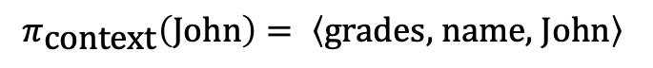
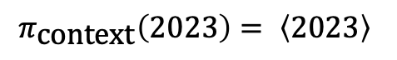
Column Header Tree as Primary Subtree
Row Label Tree as Primary Subtree
$$π_{\text{context}}\left(2023\right)= \left\langle 2023\right\rangle$$
$$π_{\text{context}}\left(\text{John}\right)= \left\langle \text{grades}\text{, }\text{name}\text{, }\text{John}\right\rangle$$

Slide 38
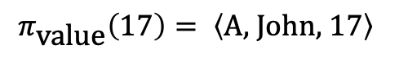
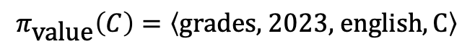
Column Header Tree as Secondary Subtree
Row Label Tree as Secondary Subtree
$$π_{\text{value}}\left(C\right)=\left\langle \text{grades}\text{, 2023, }\text{english},\text{C}\right\rangle$$
$$π_{\text{value}}\left(\text{17}\right)= \left\langle \text{A}\text{, }\text{John}\text{, }17\right\rangle$$

Slide 39
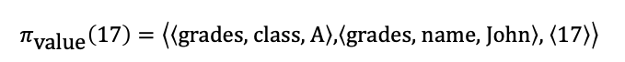
Column Header Tree as Secondary Subtree
Row Label Tree as Secondary Subtree
$$π_{\text{value}}\left(C\right)=\left\langle \left\langle \text{grades}\right\rangle \text{, }\left\langle \text{2023}\right\rangle \text{, }\left\langle \text{class}\text{, }\text{name}\text{, }\text{english}\right\rangle ,\left\langle \text{C}\right\rangle \right\rangle$$
$$π_{\text{value}}\left(\text{17}\right)=\left\langle \left\langle \text{grades}\text{, }\text{class}\text{, }\text{A}\right\rangle \text{,}\left\langle \text{grades}\text{, }\text{name}\text{, }\text{John}\right\rangle \text{, }\left\langle 17\right\rangle \right\rangle$$

Slide 40


${ T}_{1}$ |
Column Header Tree as Primary Subtree
Context String
Base:
2023:
The column header 2023 has siblings 2024. The children of 2023 are math, english.
Text-Augmentation:
${ T}_{1}$ |
Row Label Tree as Primary Subtree
Context String
Base:
John:
The row label John has siblings Tiffany.
Text-Augmentation:

Slide 41


${ T}_{1}$ |
Column Header Tree as Primary Subtree
Context String
Base:
2023:
The column header 2023 has siblings 2024. The children of 2023 are math, english.
Text-Augmentation:
${ T}_{1}$ |
Row Label Tree as Primary Subtree
Context String
Base:
grades & name & John:
The row label John represents grades, names. It has the siblings Tiffany. The values of John are:
Text-Augmentation:

Slide 42


${ \overset{⃖}{T}}_{2}$ |
Column Header Tree as Secondary Subtree
Value String
Base:
grades > 2023 > english: C
The value of the column header combination grades, 2023, english is C.
Text:
The value of the column header combination grades, 2023, english and the row label combination A, John is C.
Text-Augmentation:
${ \overset{⃖}{T}}_{2}$ |
Row Label Tree as Secondary Subtree
Value String
Base:
A > John: 17
The value of the row label combination A, John is 17.
Text:
The value of the row label combination A, John and the column header combination grades, age is 17.
Text-Augmentation:

Slide 43
${ \overset{⃖}{T}}_{2}$ |
Column Header Tree as Secondary Subtree
Value String
Base:
grades > 2023 > class & name & english: C
The value of the column header combination grades, 2023, class & name & english is C.
Text:
The value of the column header combination grades, 2023, class & name & english and the row label combination grades & class & A, grades & name & John is C.
Text-Augmentation:
${ \overset{⃖}{T}}_{2}$ |
Row Label Tree as Secondary Subtree
Value String
Base:
grades & class & A > grades & name & John: 17
The value of the row label combination grades & class & A, grades & name & John is 17.
Text:
The value of the row label combination grades & class & A, grades & name & John and the column header combination grades, class & name & age is 17.
Text-Augmentation:

Slide 44


$${root}^{r}$$
class
A
B
grades
name
John
Tiffany
Michael
17
16
17
A
B
D
C
B
D
A
C
D
B
B
D
age
grades
$${root}^{c}$$

Slide 45

$${root}^{r}$$
class
A
B
grades
name
John
Tiffany
Michael
17
16
17
A
B
D
C
B
D
A
C
D
B
B
D

Slide 46
$${root}^{r}$$
class
A
B
grades
name
John
Tiffany
Michael
17
16
17
A
B
D
C
B
D
A
C
D
B
B
D

Slide 47
$${root}^{r}$$
class
A
B
grades
name
John
Tiffany
Michael
17
16
17
A
B
D
C
B
D
A
C
D
B
B
D
age
grades
$${root}^{c}$$

Slide 48


$${root}^{c}$$
grades
grades
2023
2024
class
name
age
math
english
math
english
17
16
17
A
B
D
C
B
D
A
C
D
B
B
D
John
A
$${root}^{r}$$

Slide 49

$${root}^{c}$$
grades
grades
2023
2024
class
name
age
math
english
math
english
17
16
17
A
B
D
C
B
D
A
C
D
B
B
D

Slide 50
$${root}^{c}$$
grades
grades
2023
2024
class
name
age
math
english
math
english
17
16
17
A
B
D
C
B
D
A
C
D
B
B
D

Slide 51
$${root}^{c}$$
grades
grades
2023
2024
class
name
age
math
english
math
english
17
16
17
A
B
D
C
B
D
A
C
D
B
B
D
John
A
$${root}^{r}$$

Slide 52
<table>
<thead>
<tr>
<th colspan="7">grades</th>
</tr>
...
</thead>
<tbody>
...
</tbody>
</table>

Slide 53
grades
 |  |  | 2023 |  | 2024
class | name | age | math | english | math | english
A | John | 17 | A | C | A | B
 | Tiffany | 16 | B | B | C | B
class | name | age | french | physics | french | physics
B | Michael | 17 | D | D | D | D

Slide 54
grades
 |  |  | 2023 |  | 2024
class | name | age | math | english | math | english
A | John | 17 | A | C | A | B
 | Tiffany | 16 | B | B | C | B
class | name | age | math | english | math | english
B | Michael | 17 | D | D | D | D

Slide 55
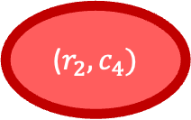
j = 1
j = 2
j = 3
j = 4
j = 5
j = 6
j = 7
i = 1
grades
 |  |  | 2023 |  | 2024
class | name | age | math | english | math | english
A | John | 17 | A | C | A | B
 | Tiffany | 16 | B | B | C | B
B | Michael | 17 | D | D | D | D
i = 2
i = 3
i = 4
i = 5
i = 6
($r_{2},c_{4})$

Slide 56
j = 1
j = 2
j = 3
j = 4
j = 5
j = 6
j = 7
i = 1
grades
 |  |  | 2023 |  | 2024
class | name | age | math | english | math | english
A | John | 17 | A | C | A | B
 | Tiffany | 16 | B | B | C | B
B | Michael | 17 | D | D | D | D
i = 2
i = 3
i = 4
i = 5
i = 6

Slide 57
j = 1
j = 2
j = 3
j = 4
j = 5
j = 6
j = 7
i = 1
grades | grades
 |  |  | 2023 |  | 2024
class | name | age | math | english | math | english
A | John | 17 | A | C | A | B
 | Tiffany | 16 | B | B | C | B
B | Michael | 17 | D | D | D | D
i = 2
i = 3
i = 4
i = 5
i = 6

Slide 58
j = 1
j = 2
j = 3
j = 4
j = 5
j = 6
j = 7
i = 1
grades | grades
 |  |  | 2023 |  | 2024
class | name | age | math | english | math | english
A | John | 17 | A | C | A | B
 | Tiffany | 16 | B | B | C | B
B | Michael | 17 | D | D | D | D
i = 2
i = 3
i = 4
i = 5
i = 6

Slide 59



Split at
$$j^{∗}=2$$
${\tilde{y}}_{14}=(\left[1, 3\right], \left[0, 0\right],“grades“)$ before: $y_{14}=(\left[3, 3\right], \left[0, 0\right],“grades“)$
${\tilde{y}}_{11}=(\left[0, 1\right], \left[0, 0\right],“grades“)$ before: $y_{11}=(\left[0, 6\right], \left[0, 0\right],“grades“)$

Slide 60
Column Headers
Row Labels

Slide 61
grades |  | grades
 |  |  | 2023 |  | 2024
class | name | age | math | english | math | english
A | John | 17 | A | C | A | B
 | Tiffany | 16 | B | B | C | B
B | Michael | 17 | D | D | D | D

Slide 62


$${root}^{c}$$
grades
grades
2023
2024
class
name
age
math
english
math
english
John
Tiffany
Michael
17
16
17
A
B
D
C
B
D
A
C
D
B
B
D
A
B
$${root}^{r}$$

Slide 63

$${root}^{context−inter}$$
grades
grades
2023
2024
A
class
B
name
age
math
english
math
english

Slide 64
$${root}^{context−inter}$$
grades
grades
2023
2024
A
class
name
age
math
english
math
english
B
John
Tiffany
Michael

Slide 65
grades
class

Slide 66

$${root}^{r}$$
A
B
John
Tiffany
Michael
17
16
17
A
B
D
C
B
D
A
C
D
B
B
D

Slide 67
$${root}^{c}$$
grades
2023
2024
name
age
math
english
math
english
John
Tiffany
Michael
17
16
17
A
B
D
C
B
D
A
C
D
B
B
D

Slide 68
Column Header Tree
Row Label Tree

Slide 70
HTML Table
TabTree Model
Table Serialization

Slide 71

DFS-based Serialized String
TabTree Model
Modular System
Base
Context String Generation Approach
Text-Augmentation
Base
Value String Approach
Text
Text-Augmentation
Column Header 1st
Primary Subtree Selection
Row Label 1st
Concatenation
Heuristic

Slide 72


$${root}^{c}$$
grades
grades
2023
2024
class
name
age
math
english
math
english
17
16
17
A
B
D
C
B
D
A
C
D
B
B
D
name
John
Tiffany
Michael
grades
class
A
B
$${root}^{r}$$

Slide 73
$${root}^{c}$$
grades
grades
2023
2024
class
name
age
math
english
math
english
17
16
17
A
B
D
C
B
D
A
C
D
B
B
D
name
John
Tiffany
Michael
grades
class
A
B
$${root}^{r}$$

Slide 74

$${root}^{c}$$
grades
grades
2023
2024
class
name
age
math
english
math
english
17
16
17
A
B
D
C
B
D
A
C
D
B
B
D
John
Tiffany
Michael
A
B
$${root}^{r}$$

Slide 75

$${root}^{c}$$
grades
grades
2023
2024
class
name
age
math
english
math
english
17
16
17
A
B
D
C
B
D
A
C
D
B
B
D

Slide 76

$${root}^{r}$$
class
A
B
grades
name
John
Tiffany
Michael
17
16
17
A
B
D
C
B
D
A
C
D
B
B
D

Slide 77
$${root}^{c}$$
grades
2023
2024
age
math
english
math
english
17
16
17
A
B
D
A
B
D
A
C
D
B
B
D
A
B
$${root}^{r}$$

Slide 79
j = 1
j = 2
j = 3
j = 4
j = 5
j = 6
j = 7
i = 1
grades
 |  |  | 2023 |  | 2024
class | name | age | math | english | math | english
A | John | 17 | A | C | A | B
 | Tiffany | 16 | B | B | C | B
B | Michael | 17 | D | D | D | D
i = 2
i = 3
i = 4
i = 5
i = 6

Slide 80


j = 1
j = 2
j = 3
j = 4
j = 5
j = 6
j = 7
i = 1
grades
 |  |  | 2023 |  | 2024
class | name | age | math | english | math | english
A | John | 17 | A | C | A | B
 | Tiffany | 16 | B | B | C | B
B | Michael | 17 | D | D | D | D
i = 2
i = 3
i = 4
i = 5
$γ_{24}=(\left[0, 1\right], \left[0,0\right],“2023“)$
i = 6
j = 1
j = 2
j = 3
j = 4
j = 5
j = 6
j = 7
i = 1
$γ_{51}=(\left[0, 0\right], \left[1,0\right],“A“)$
grades
 |  |  | 2023 |  | 2024
class | name | age | math | english | math | english
A | John | 17 | A | C | A | B
 | Tiffany | 16 | B | B | C | B
B | Michael | 17 | D | D | D | D
i = 2
i = 3
i = 4
i = 5
i = 6

Slide 81


j = 1
j = 2
j = 3
j = 4
j = 5
j = 6
j = 7
j = 1
j = 2
j = 3
j = 4
j = 5
j = 6
j = 7
i = 1
grades
 |  |  | 2023 |  | 2024
class | name | age | math | english | math | english
A | John | 17 | A | C | A | B
 | Tiffany | 16 | B | B | C | B
B | Michael | 17 | D | D | D | D
i = 1
$γ_{51}=(\left[0, 0\right], \left[1,0\right],“A“)$
grades
 |  |  | 2023 |  | 2024
class | name | age | math | english | math | english
A | John | 17 | A | C | A | B
 | Tiffany | 16 | B | B | C | B
B | Michael | 17 | D | D | D | D
i = 2
i = 2
i = 3
i = 3
i = 4
i = 4
i = 5
$γ_{24}=(\left[0, 1\right], \left[0,0\right],“2023“)$
i = 5
i = 6
i = 6

Slide 82

j = 1
j = 2
j = 3
j = 4
j = 5
j = 6
j = 7
i = 1
grades
 |  |  | 2023 |  | 2024
class | name | age | math | english | math | english
A | John | 17 | A | C | A | B
 | Tiffany | 16 | B | B | C | B
B | Michael | 17 | D | D | D | D
i = 2
i = 3
i = 4
i = 5
$γ_{24}=(2, 2, \left[0, 1\right], \left[1,0\right],“2023“)$
i = 6

Slide 83




Qdrant Collection
Most Relevant Full Documents
Question
Query Embedding
Top-K Chunks
-> Similar to Document Embeddings: Snowflake Arctic-embed-m-v1.5
-> Distance Metric: Cosine Similarity
Query
Context
Prompt
You are tasked with answering questions based on specific financial documents. Your task is to give the correct answer based on the given context. Respond with only the answer. Do not include words like "Answer" or "Response." Provide the answer as either:
- A number for questions about revenue, profit, or quantities.
- A word or phrase for questions about products, categories, or names.
- 'None' if the context doesn't provide information about the given question.
[…]
Example:
- What was the sales revenue of Company Y from 2022 to 2024?
2,500
[…]
Context: \n {context}
Question: \n {question}
LLM
-> Huggingface Inference API - mistralai/Mistral-Nemo-Instruct-2407
Evaluation
Answer
-> Accuracy, F1 Score

Slide 84
Question / Query
Query Embedding
Vector Store
Top-K Chunks
Similarity Metric
Query
Context
Prompt
LLM
Answer
Evaluation

Slide 85
Question / Query
Query Embedding
Vector Store
Top-K Chunks
Similarity Metric
Query
Context
Prompt
LLM
Answer
Evaluation

Slide 86
Retrieval & Text Generation
Vanilla RAG
Retrieval & Text Generation
Table QA Framework

Slide 87
<table>
<tr>
<tr>
<tr>
<tr>
…
Operating Revenues
Other
Total Regulated Businesses
$
Water
779
3,593
$
Wastewater
30
327
$
Total
809
3,920
$
% of Total
20.6
%
100.0
%

Slide 88
<table>
<tr>
<tr>
<tr>
<tr>
…
Operating Revenues
Other
Total Regulated Businesses
$
Water
779
3,593
$
Wastewater
30
327
$
Total
809
3,920
$
% of Total
20.6
%
100.0
%

Slide 89
<table>
Operating Revenue (in mio.)
Water
Wastewater
Total
% of Total
Pennsylvania: 810
Pennsylvania: 155
Pennsylvania: 965
Pennsylvania: 24.6
…
…
…
…
New Jersey: 908
New Jersey: 57
New Jersey: 965
New Jersey: 24.6
Total Regulated Business: 3,593
Total Regulated Business: 327
Total Regulated Business: 3,920
Total Regulated Business: 100

Slide 90
<table>
name
John C. Griffith
Melanie M. Kennedy
Cheryl Norton
age: 57
age: 50
age: 59
office: CFO
office: CHRO
office: COO

Slide 92
<table>
<tr>
<tr>
<tr>
<tr>
…
Operating Revenues
Other
Total Regulated Businesses
$
Operating Revenues
Operating Revenues
Water
Water
779
3,593
$
Operating Revenues
Operating Revenues
Wastewater
Wastewater
30
327
$
Operating Revenues
Operating Revenues
Total
Total
809
3,920
$
Operating Revenues
Operating Revenues
% of Total
% of Total
20.6
%
100.0
%

Slide 93
<table>
How much was the total regulated business revenue of American Water Works in 2023 for the wastewater sector?
<tr>
<tr>
<tr>
<tr>
…
Operating Revenues
Other
Total Regulated Businesses
$
Operating Revenues
Operating Revenues
Water
Water
779
3,593
$
Operating Revenues
Operating Revenues
Wastewater
Wastewater
30
327
$
Operating Revenues
Operating Revenues
Total
Total
809
3,920
$
Operating Revenues
Operating Revenues
% of Total
% of Total
20.6
%
100.0
%

Slide 94
<table>
How much was the total regulated business revenue of American Water Works in 2023 for the wastewater sector?
<tr>
<tr>
<tr>
<tr>
…
Operating Revenues
Other
Total Regulated Businesses
$
Water
779
3,593
$
Wastewater
30
327
$
Total
809
3,920
$
% of Total
20.6
%
100.0
%

Slide 95
<table>
<col>
<col>
<col>
<col>
…
Pennsylvania
New Jersey
$
$
Other
779
Total Regulated Businesses
$
Missouri
Illinois
30
809
3,593
$
California
Total Top 5
20.6
%
327
$
Other
Total Regulated Businesses
3,920
$
100.0
%

Slide 96
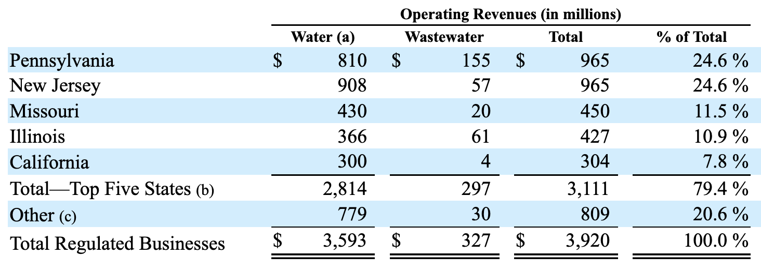
No thead tags in HTML
Multi-line headers
No HTML structure for column index
Semantically different table structures
(e.g., transposed tables)

Slide 97
Prompt
You are tasked with analyzing table data to determine whether the provided row should be classified as a header or not.
Instructions:
1. Review the provided row and the next and previous rows.
2. Consider typical properties of a header row when making your determination. For header rows typically yield (…)
3. End your response with one of the following:
- "Answer: Yes" if the row represents a header row.
- "Answer: No" if the row contains actual records or entries (e.g., numerical values, measurements, metrics or attributes corresponding to a category).
4. Reason your answer with maximum 150 tokens.
Row to analyze:
['A', 'John', '17', 'A', 'C', 'A', 'B', ’’]
The row index of the provided row is 3.
The previous row looks like this: ['class', 'name', 'age', 'math', 'english', 'math', 'english', ’’]
The second previous row looks like this: ['', '', '', '2023 (colspan: 2)', '2024 (colspan: 2)', ’’]
The next row looks like this: ['A', 'Martin', '17', 'A', 'C', 'A', 'B', ’’]
The second next row looks like this: ['A', 'Tiffany', '16', 'B', 'B', 'C', 'B', '']
Response
LLM
The row to analyze contains the values ['A', 'John', '17', 'A', 'C', 'A', 'B', ''], which appears to represent a record of an individual rather than a header. The previous row, ['class', 'name', 'age', 'math', 'english', 'math', 'english', ''], clearly defines the categories of data, indicating that it is a header row. The subsequent rows contain similar individual entries. Therefore, the row does not serve the purpose of labeling or providing context for the data below it.
Answer: No

Slide 98





Occurrences Check
Spotify API
List of Artists
Final Raw
Data
German S
Preprocessing
Sentiment Analysis
Genuis API
Lyrics Data
Final Results
German S
Pretrained Classification Model

